Slide 1
Machine Learning AIML CLZG565
M3 : Linear Models for Regression
Dr. Sugata Ghosal
sugata.ghosal@pilani.bits-pilani.ac.in

Slide 2
Linear Regression

Slide 3
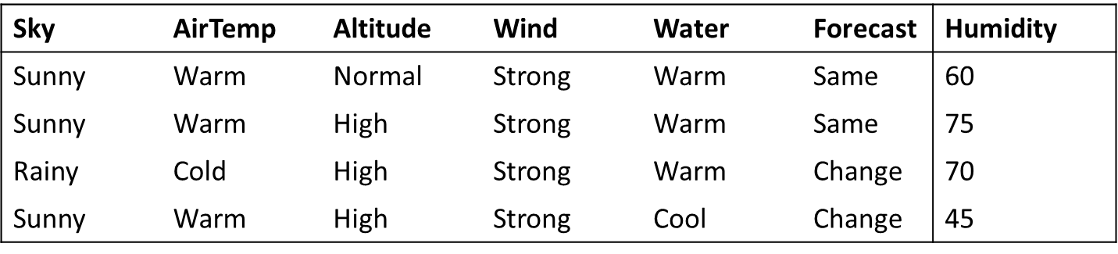
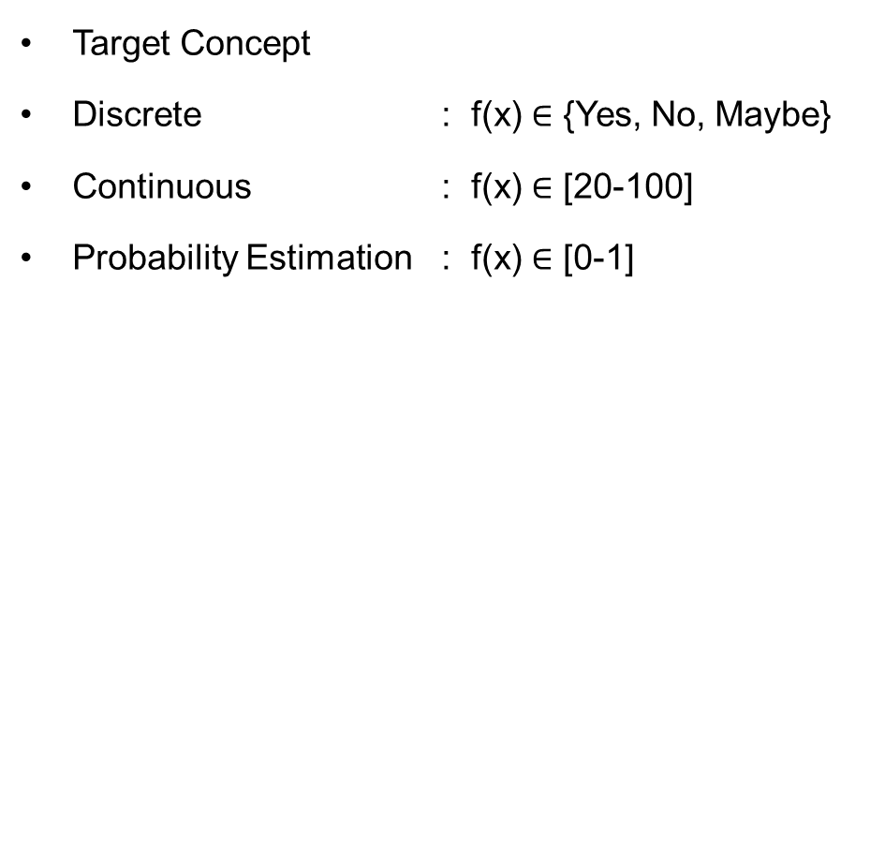
Inductive Learning Hypothesis : Interpretation
Target Concept
Discrete : f(x) $∈$ {Yes, No, Maybe}
Continuous : f(x) $∈$ [20-100]
Probability Estimation : f(x) $∈$ [0-1]
Classification
Regression

Slide 4




Formal Representation: Interpretation
Supervised Learning: Regression
GOAL : Previously unseen records should be assigned a value as accurately as possible.
Given (x₁, y₁), (x₂, y₂), ..., (x_{n}, y_{n})
Learn a function f (x) to predict y given x
– y is real-valued
9
8
7
6
5
4
3
2
1
0
1970 1980
September Arctic Sea Ice Extent (1,000,000 sq km)
1990
2000
2010
2020
Year Number

Slide 5
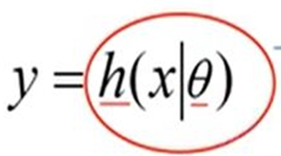

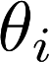
Machine Learning Process : Interpretation
Training Set
Price
(in 1000s of dollars)
Learning Algorithm
Size (feet²)
Size in feet² (x) | Price ($) in 1000's (y)
2104 | 460
1416 | 232
1534 | 315
852 | 178
… | …
Size of house
h
Estimated price
Hypothesis:
‘s : Parameters
h(.) : Model
How to choose ‘s ?

Slide 6
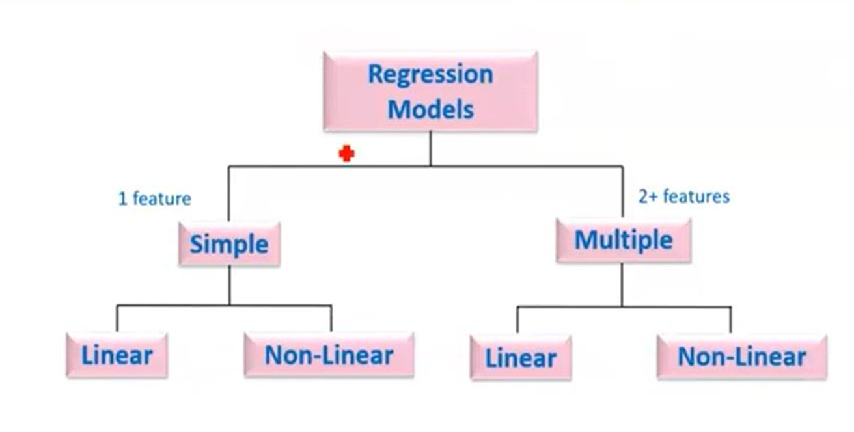
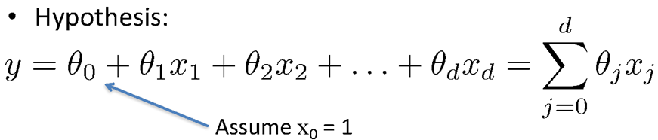
Types of Regression Models
simple regression model
(Education) x y (Income)
(Education) x₁
(Soft Skills) x₂
(Experience) x₃
(Age) x₄
multiple regression model
y (Income)

Slide 7

Learning the Model Parameters
Closed Form Solution Approach
Gradient Descent Approach

Slide 8
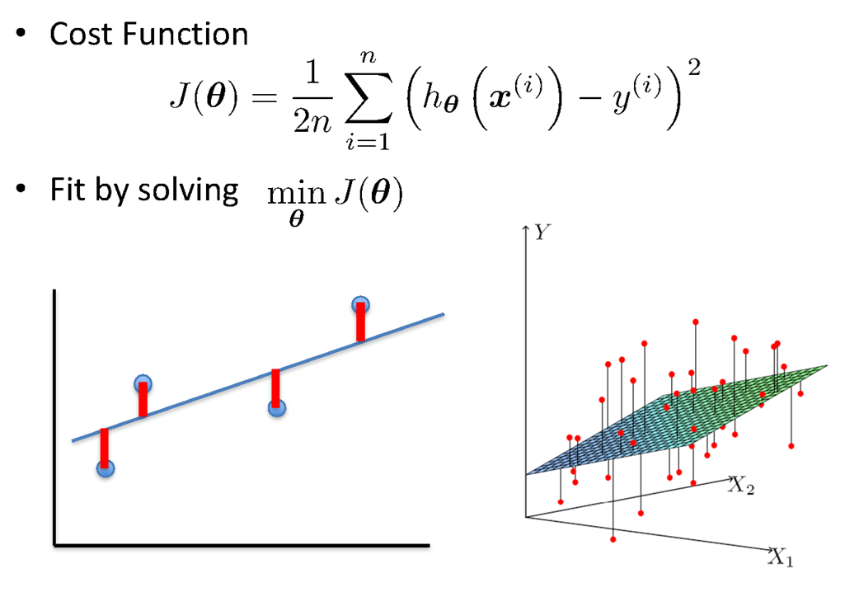
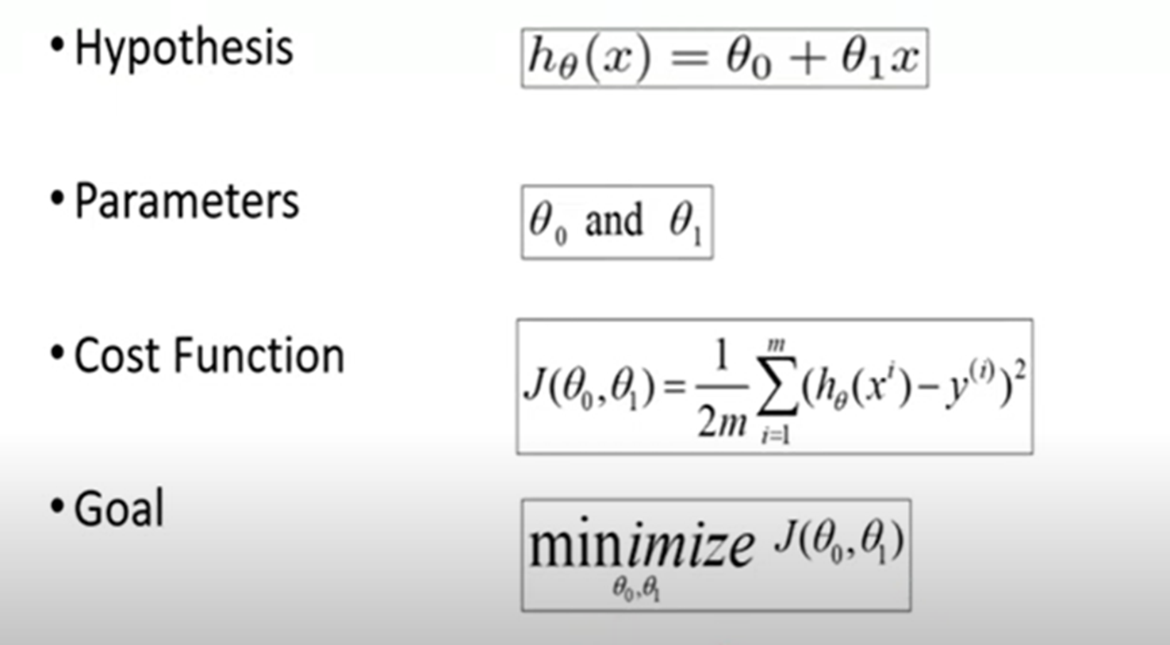
Linear Regression : Least Squares

Slide 9
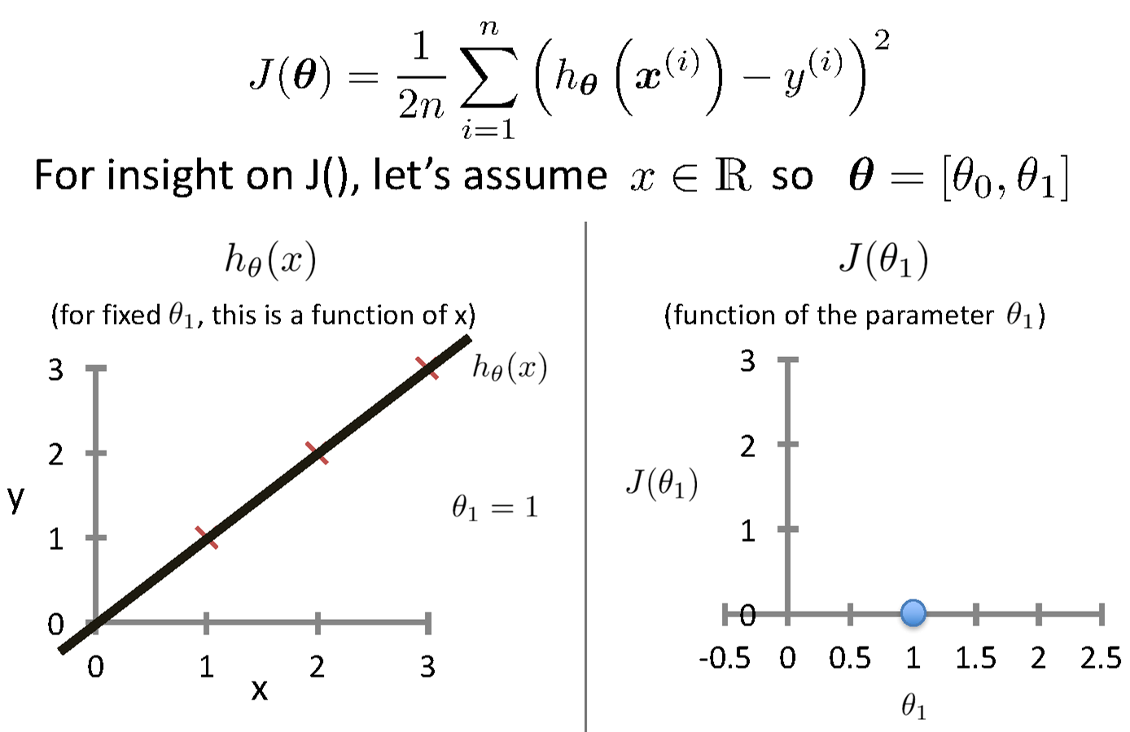
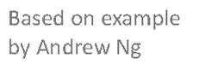
Intuition Behind Cost Function
Source Credit :

Slide 10
Intuition Behind Cost Function
Source Credit :

Slide 11
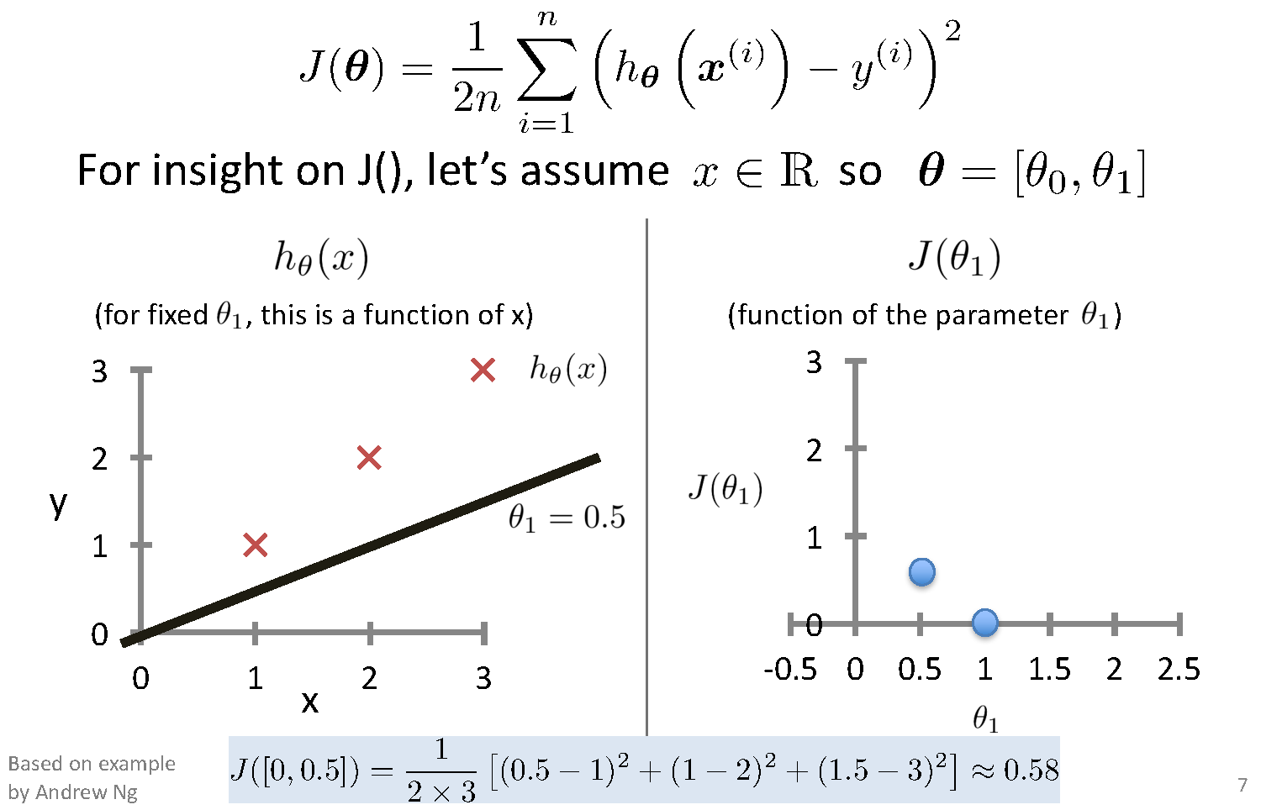
Intuition Behind Cost Function

Slide 12
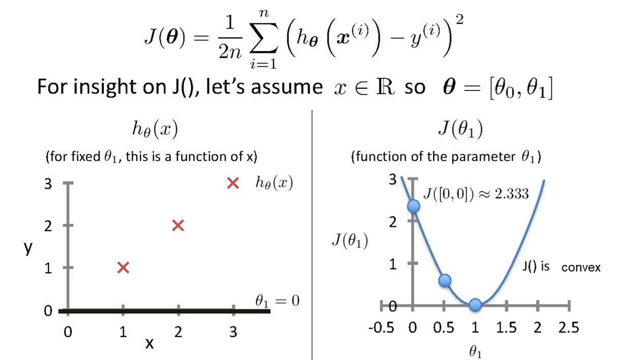
Intuition Behind Cost Function
Source Credit :

Slide 13
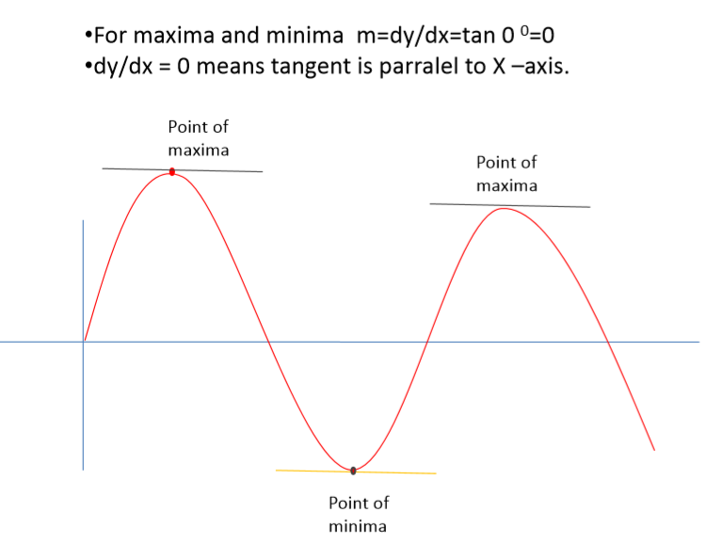
Maxima and Minima

Slide 14
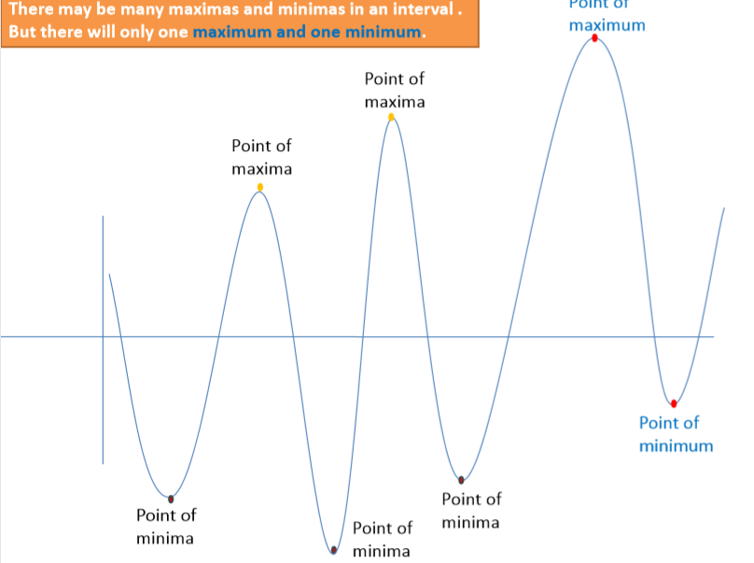
Notion of Maxima and Minima of a function
In Machine Learning
CarPrice = 1 + 0.05Mileage
CarPrice = 1 + 0.25Mileage
CarPrice = 1 + 0.75Mileage
15.7
15.3
Weight of Mileage
Mileage (in kmpl) | Car Price (in cr)
9.8 | 10.48
9.12 | 1.75
9.5 | 6.95
10 | 2.51
12.4
Sum of absolute Error
/ Training Error

Slide 15
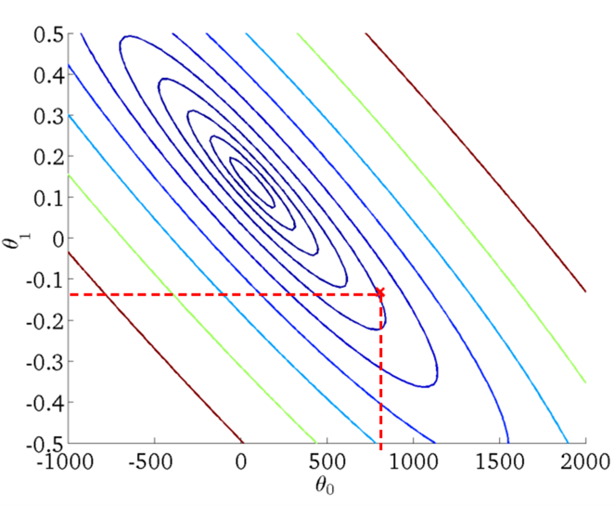
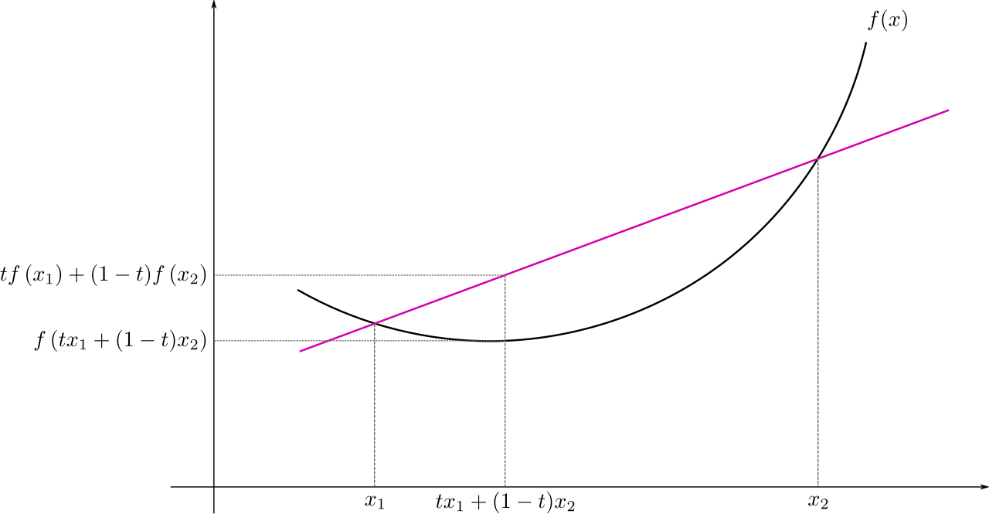
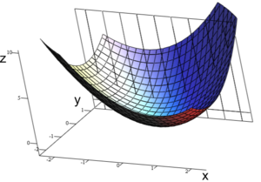
: Multivariate
Convex Function
Real-valued function defined on an n-dimensional interval is called convex if the line segment between any two points on the graph of the function lies above or on the graph

Slide 16
Closed Form Solution

Slide 17
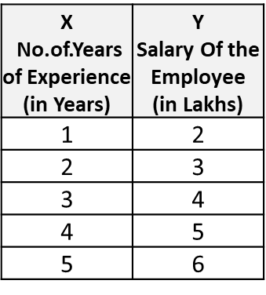
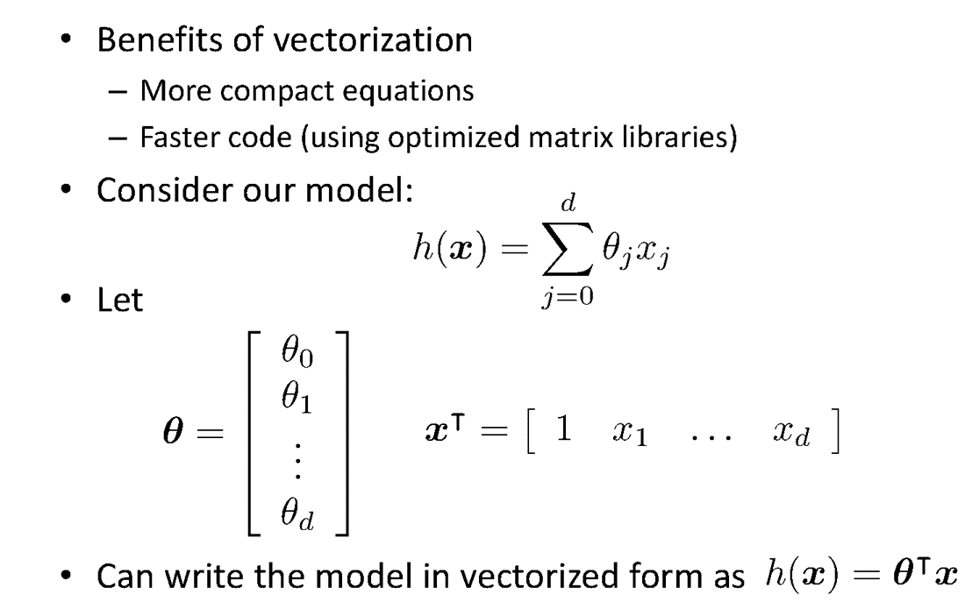
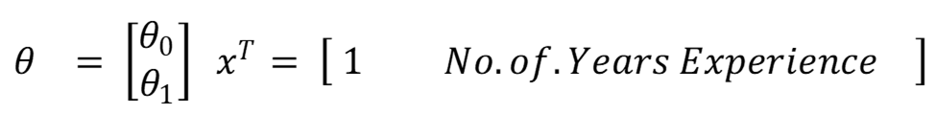
Vectorization

Slide 18
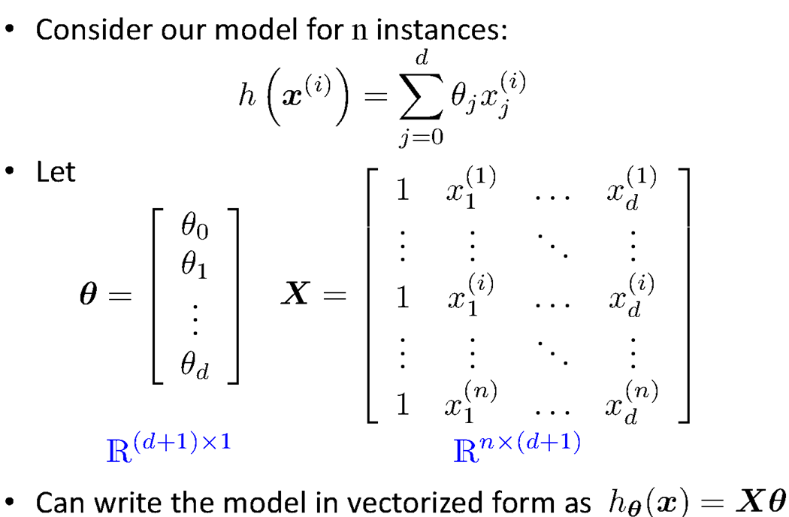
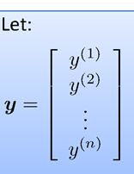
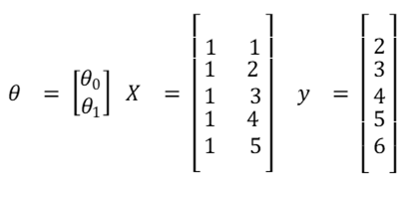
Vectorization

Slide 19
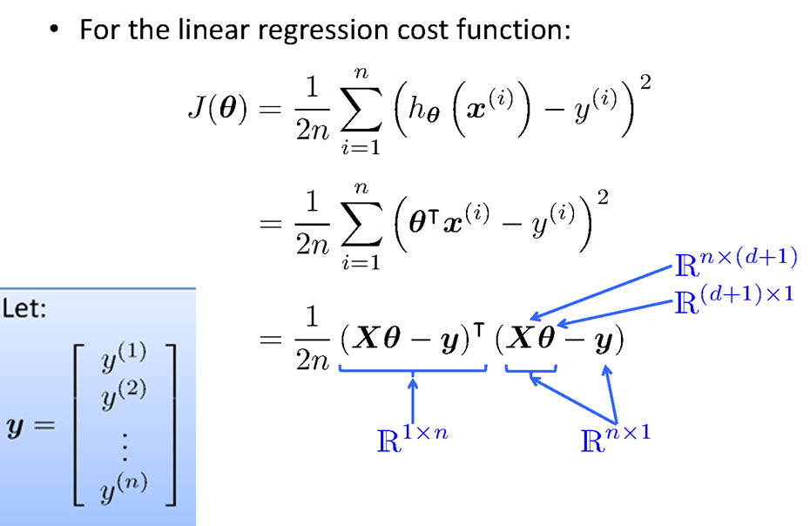
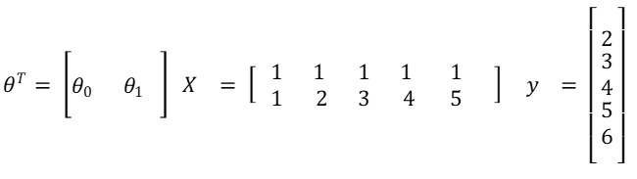
Vectorization

Slide 20
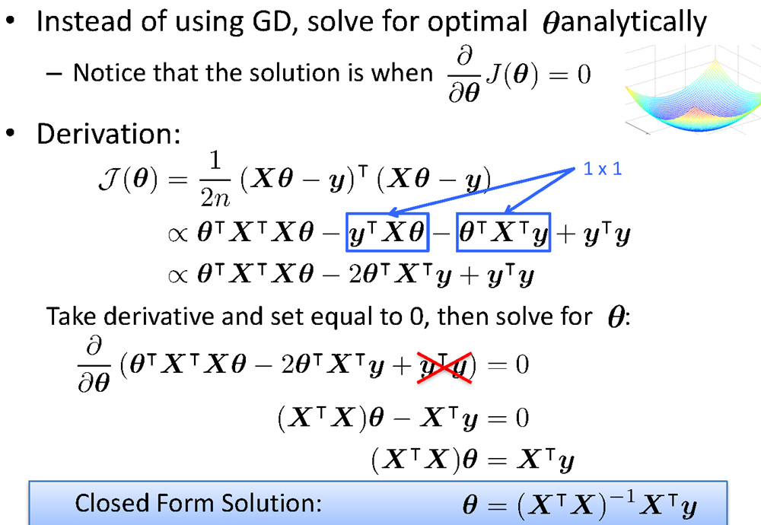
Vectorization

Slide 21
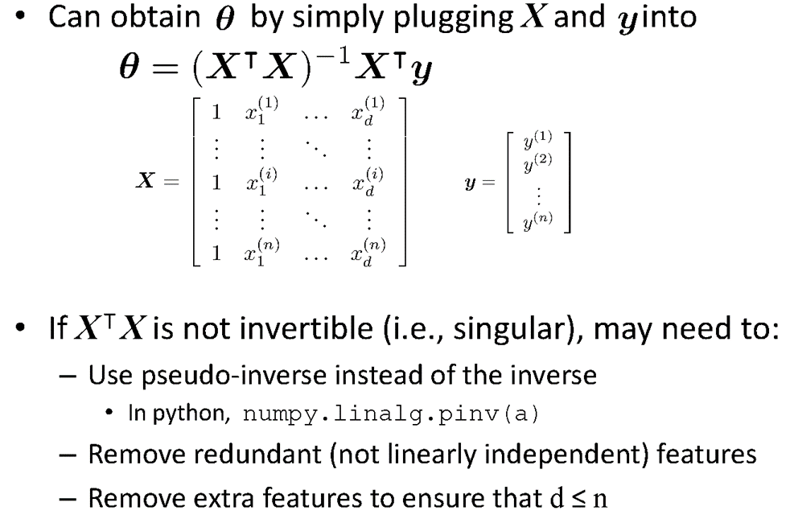
Vectorization

Slide 22
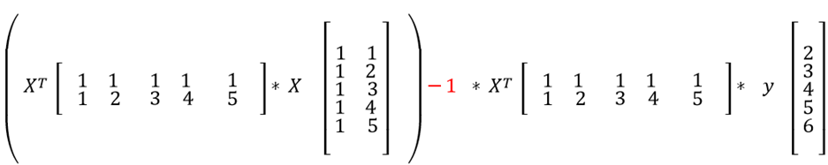
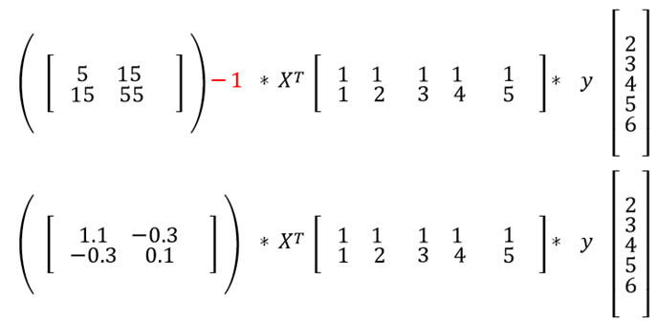
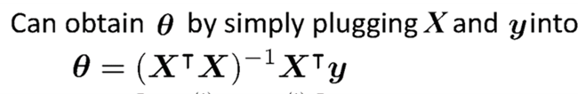
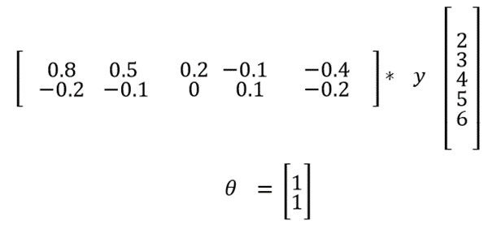
Fit the Linear Regression Model :
Using Closed Form

Slide 23
Gradient Descent Approach

Slide 24
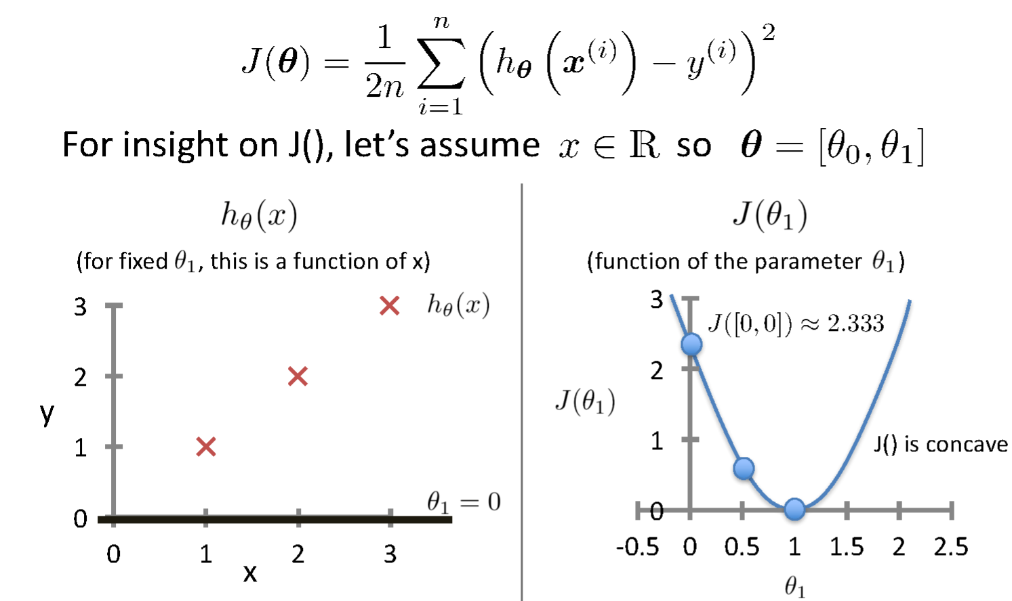
Intuition Behind Cost Function
Source Credit :

Slide 25
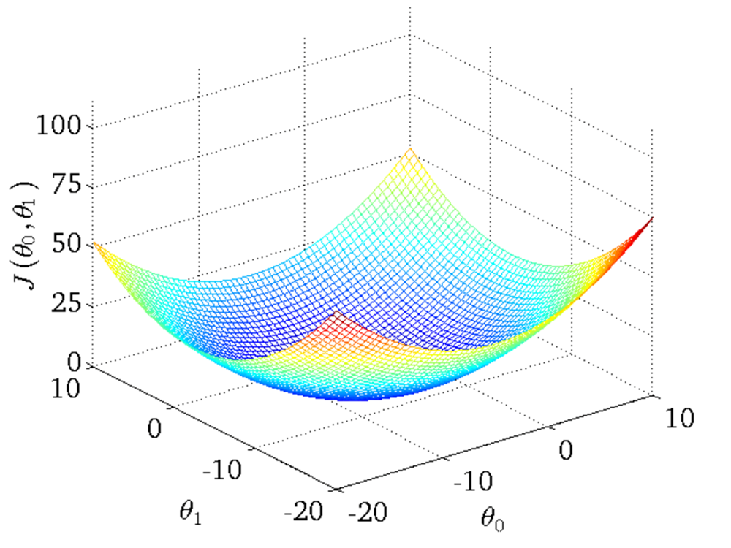
Intuition Behind Cost Function
Source Credit :

Slide 26
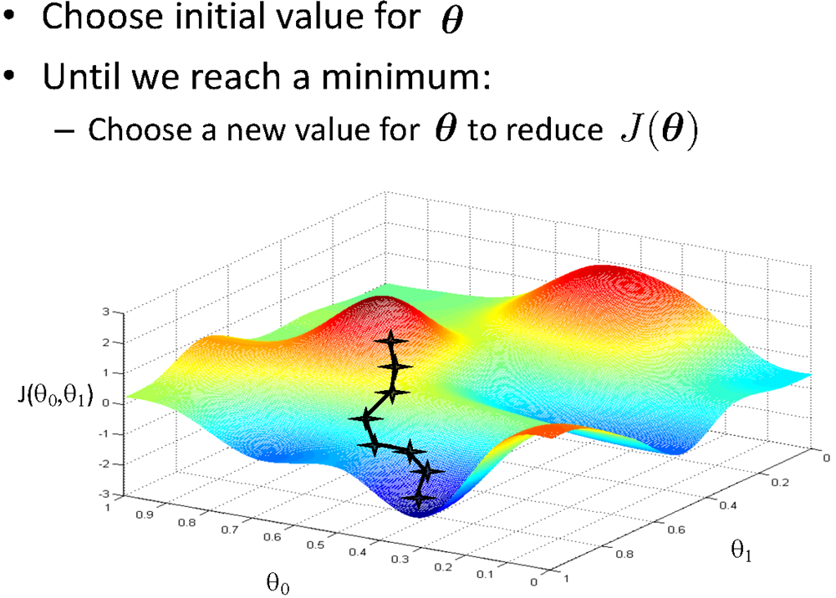
Basic Search Procedure
Source Credit : Figure by Andrew Ng

Slide 27
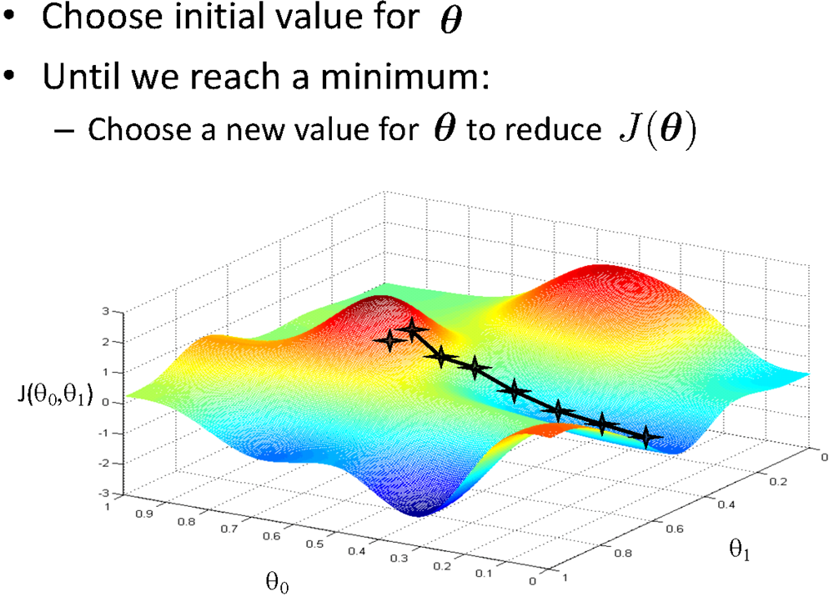
Basic Search Procedure
Source Credit : Figure by Andrew Ng

Slide 28
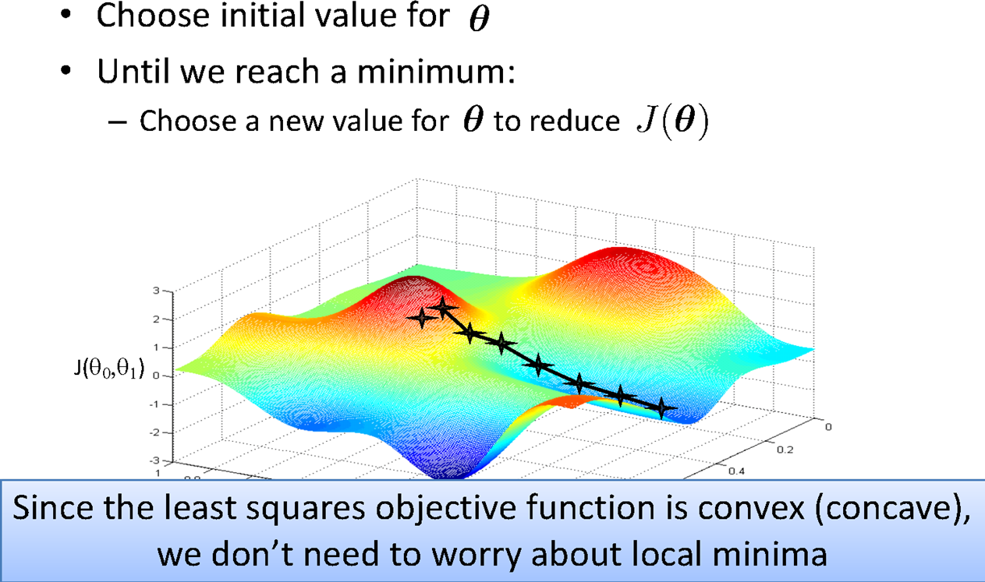
Basic Search Procedure
Source Credit : Figure by Andrew Ng

Slide 29
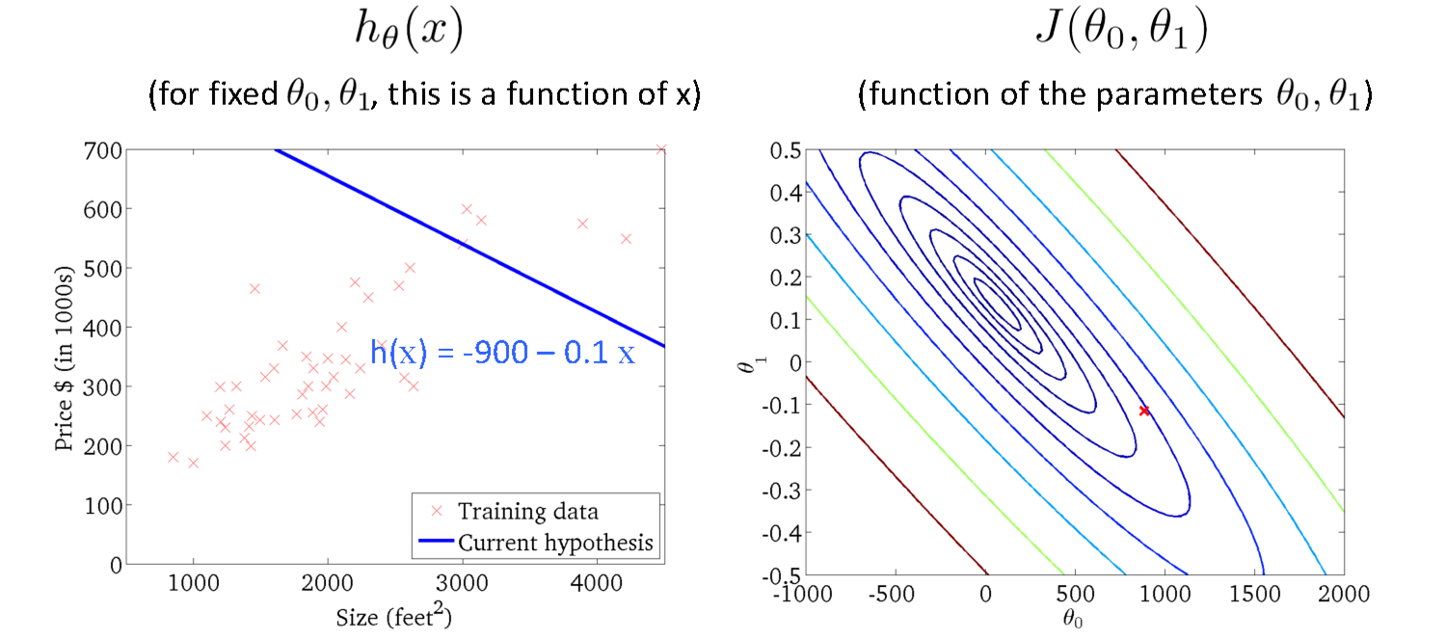
Gradient Descent
Size in feet² (x) | Price ($) in 1000's (y)
2104 | 460
1416 | 232
1534 | 315
852 | 178
… | …
Source Credit : Slide by Andrew Ng

Slide 30
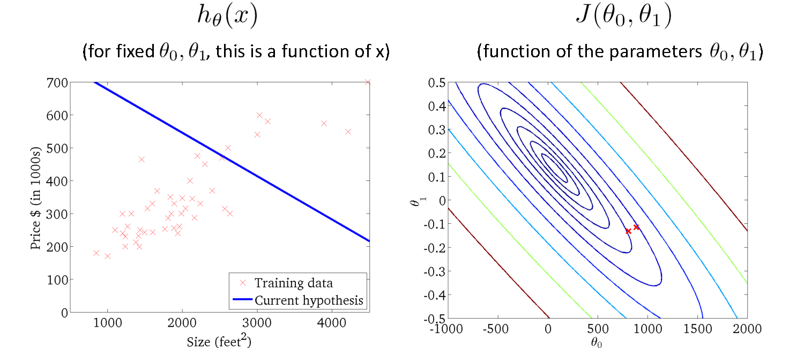
Gradient Descent
Source Credit : Slide by Andrew Ng

Slide 31
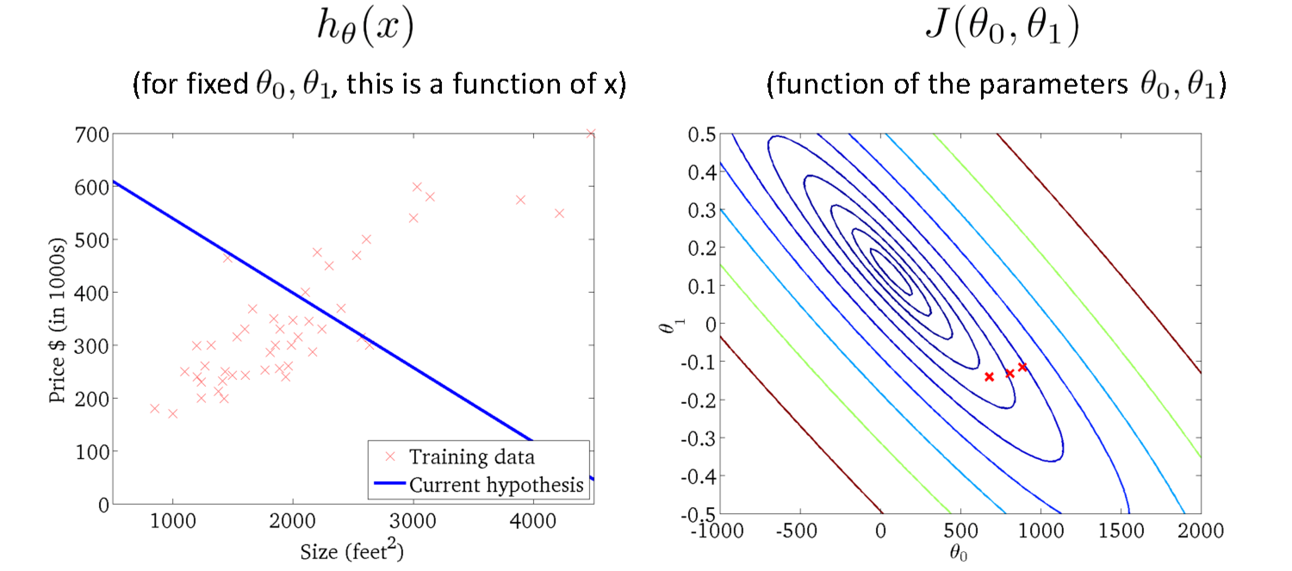
Gradient Descent
Source Credit : Slide by Andrew Ng

Slide 32
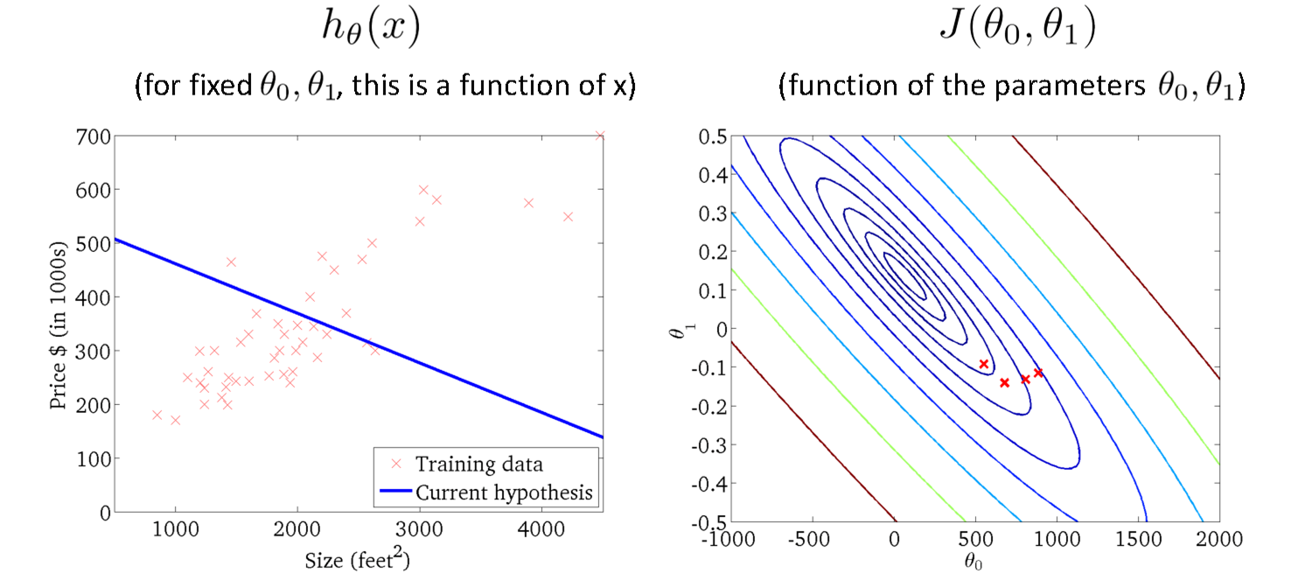
Gradient Descent
Source Credit : Slide by Andrew Ng

Slide 33
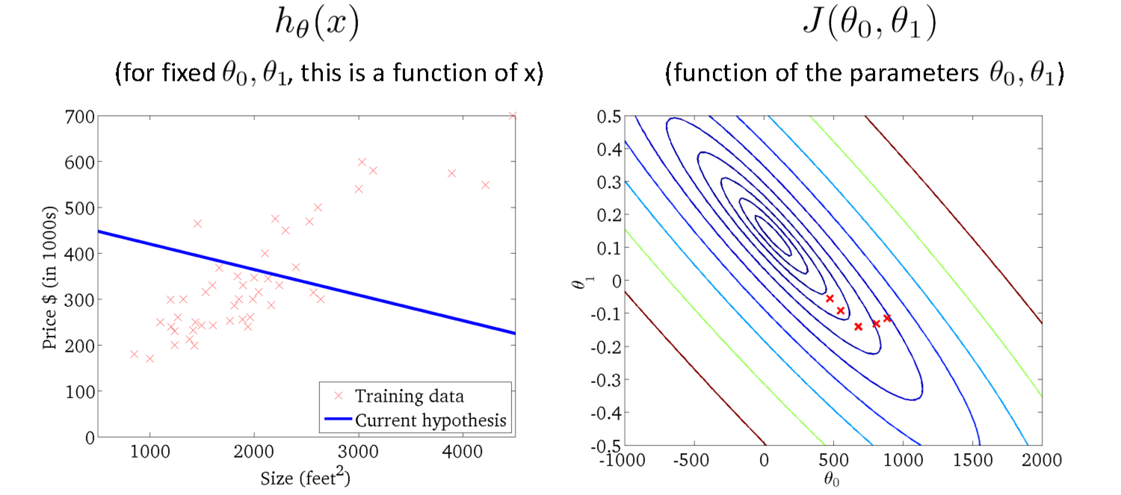
Gradient Descent
Source Credit : Slide by Andrew Ng

Slide 34
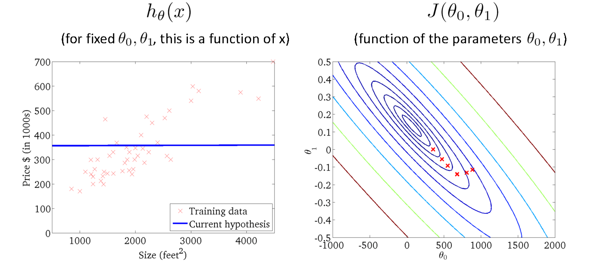
Gradient Descent
Source Credit : Slide by Andrew Ng

Slide 35
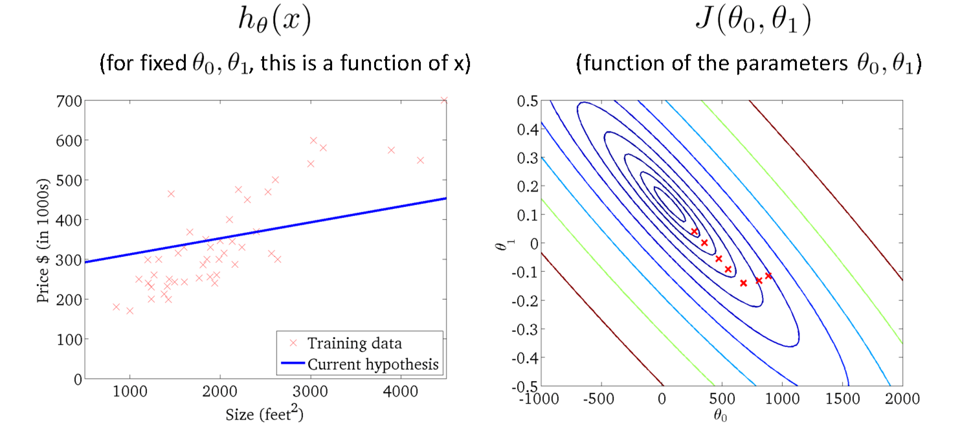
Gradient Descent
Source Credit : Slide by Andrew Ng

Slide 36
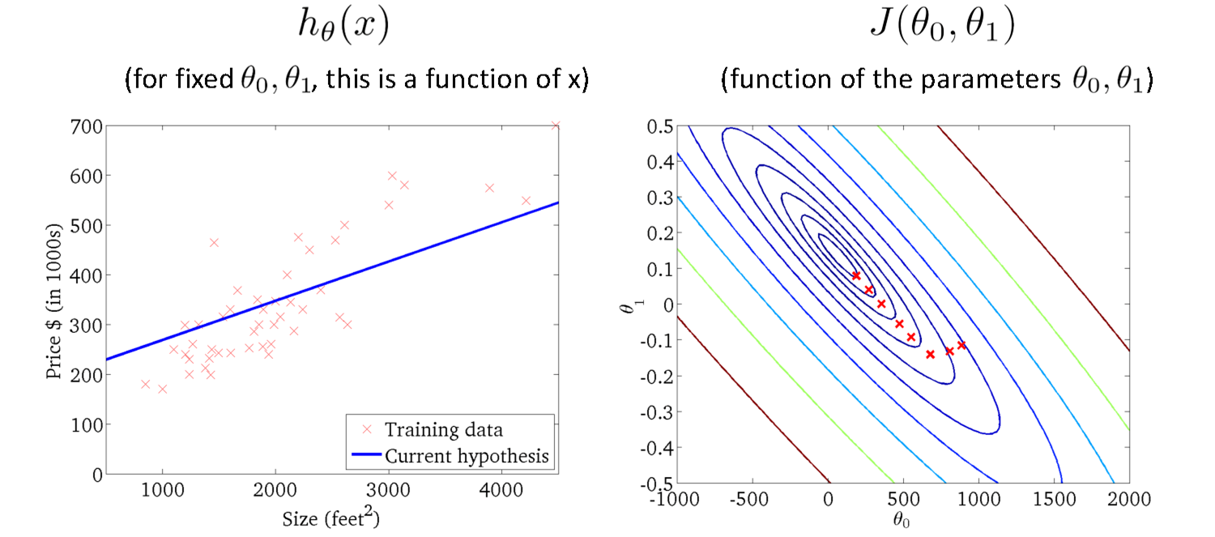
Gradient Descent
Source Credit : Slide by Andrew Ng

Slide 37
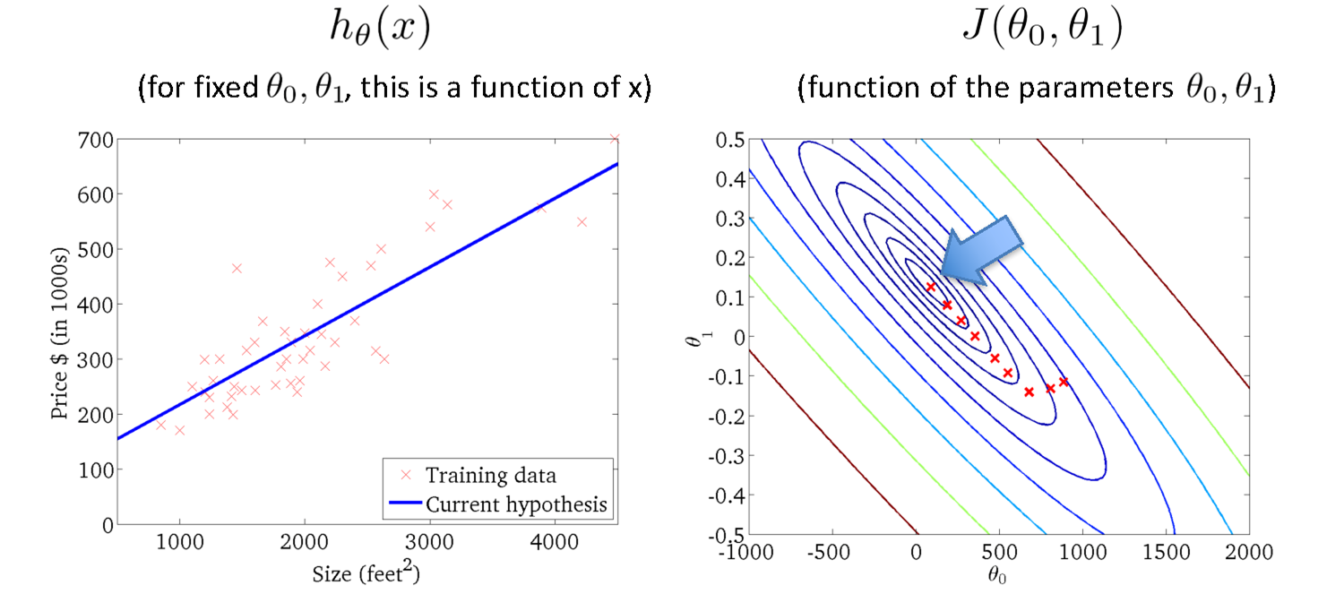
Gradient Descent
Source Credit : Slide by Andrew Ng

Slide 38
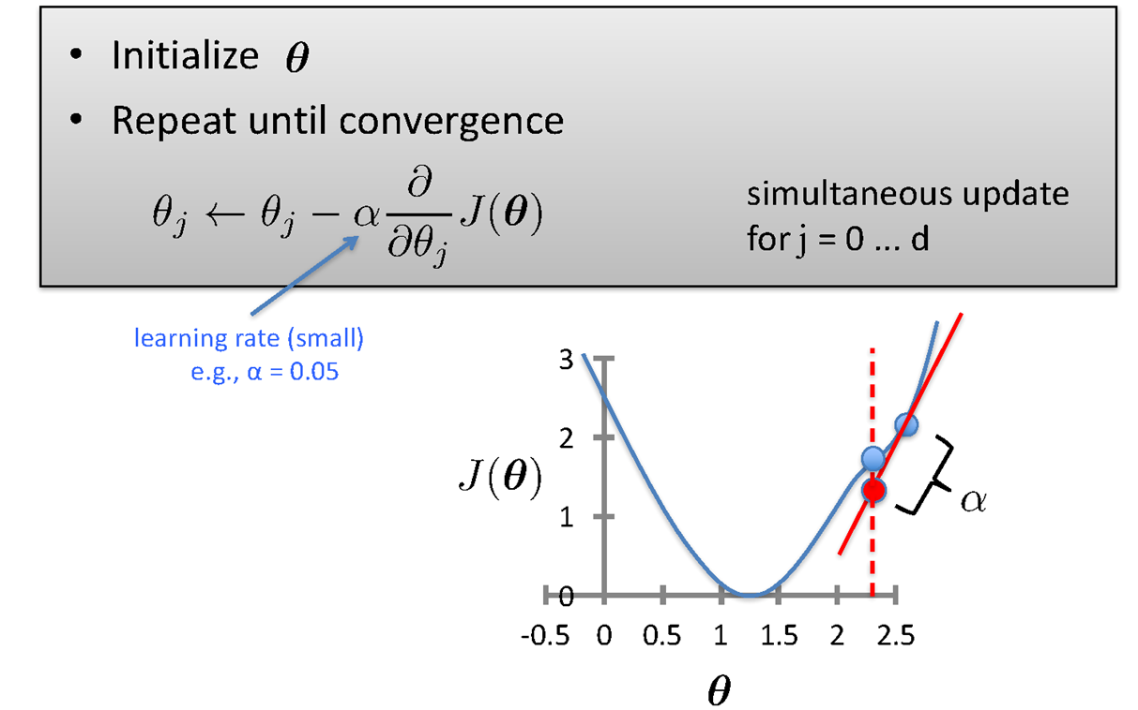
Gradient Descent

Slide 39
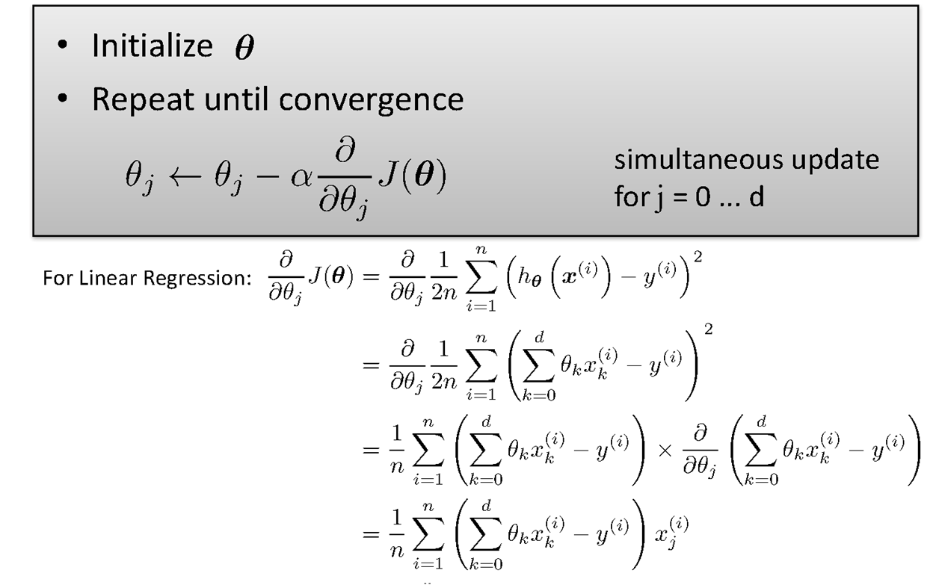
Gradient Descent

Slide 40
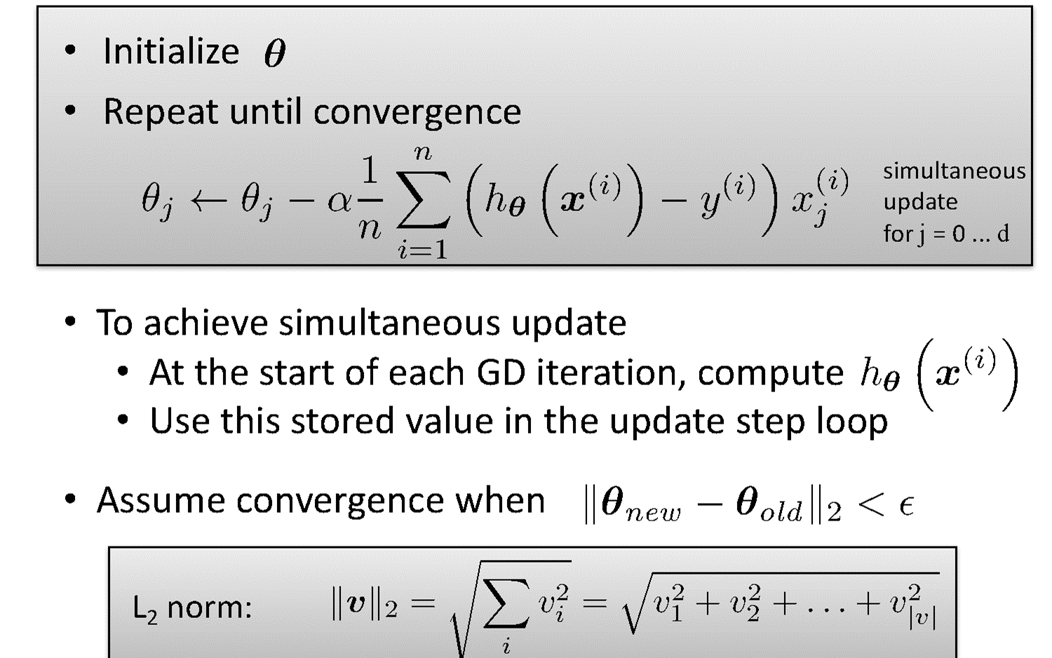
Gradient Descent for Linear Regression

Slide 41

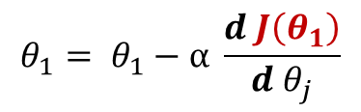

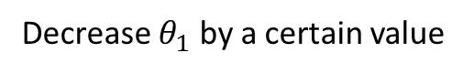

Guarantee of Convergence
$$J$$
$$θ_{1}= θ_{1}−α \frac{d J\left(θ_{1}\right)}{d{ θ}_{j}}$$
$$= θ_{1}−α (Positive Number)$$
Positive Derivative
Decrease $θ_{1}$ by a certain value
𝞱₁
$$J$$
𝞱₁
𝞱₁
New 𝞱₁
Old 𝞱₁
Source Credit: Prof. Mohammad Hammoud

Slide 42



Guarantee of Convergence
$$J$$
$$θ_{1}= θ_{1}−α \frac{d J\left(θ_{1}\right)}{d{ θ}_{j}}$$
$$= θ_{1}−α (Negative Number)$$
Negative Derivative
Increase $θ_{1}$ by a certain value
𝞱₁
𝞱₁
𝞱₁
Old 𝞱₁
New 𝞱₁
Source Credit: Prof. Mohammad Hammoud

Slide 43

Choosing Learning Rate

Slide 44

Gradient Descent algorithm : Effect of Feature Scaling

Slide 45

Gradient Descent algorithm : Effect of Learning Rate

Slide 46

Gradient Descent: Variants
Batch gradient descent refers to calculating the derivative from all training data before calculating an update.
Minibatch refers to calculating derivative of mini groups of training data before calculating an update.
Stochastic gradient descent refers to calculating the derivative from each training data instance and calculating the update immediately

Slide 47


Gradient Descent: Variants
Batch gradient descent refers to calculating the derivative from all training data before calculating an update.
Minibatch refers to calculating derivative of mini groups of training data before calculating an update.
Stochastic gradient descent refers to calculating the derivative from each training data instance and calculating the update immediately

Slide 48
Fit a linear Regression Line : Gradient Descent
Steps :
(Assuming : ‘n’ no. of instances and two predictors {x1, x2} and linear regression)
Identification of the equations y = w0+w1X1+W2X2
Cost function & derivative
W0` = w0 – 1/n * learning rate * (sum (w0+w1X1+W2X2 - y))
W1` = w1 – 1/n * learning rate * (sum (w0+w1X1+W2X2 - y) * x1)
W2` = w2 – 1/n * learning rate * (sum (w0+w1X1+W2X2 - y)*x2)
Apply the equations

Slide 49

Fit a linear Regression Line : Gradient Descent
Fit a linear regression. Show only the first iteration of Gradient descent algorithm using learning rate of 0.02 for the following data , if the Relative Risk of Coronary Heart Disease is believed to be only linearly dependent on BMI as well as Diastolic Pressure. Assume the intercept of the regression model as 5 and the slope of independent variables as -0.03 (negative).
Steps :
Identification of the equations y = w0+w1X1+W2X2
Cost function & derivative
W0` = w0 – 1/3 * learning rate * (sum (w0+w1X1+W2X2 - y))
W1` = w1 – 1/3 * learning rate * (sum (w0+w1X1+W2X2 - y) * x1)
W2` = w2 – 1/3 * learning rate * (sum (w0+w1X1+W2X2 - y)*x2)
Apply the equations

Slide 50
Fit a linear Regression Line : Gradient Descent
Fit a linear regression. Show only the first iteration of Gradient descent algorithm using learning rate of 0.02 for the following data , if the Relative Risk of Coronary Heart Disease is believed to be only linearly dependent on BMI as well as Diastolic Pressure. Assume the intercept of the regression model as 5 and the slope of independent variables as -0.03 (negative).
Steps :
Identification of the equations: RR-CHD = 5 – 0.03 * BMI – 0.03 * DiastolicPressure
Cost function & derivative
W0` = w0 – 1/3 * 0.02 * (sum (5-0.03BMI-0.03DiastolicPresure - RRCHD))
= 5 – 1/3 * 0.02 * (sum (5-0.03BMI-0.03DiastolicPresure - RRCHD))
W1` = w1 – 1/3 * 0.02 * (sum (5-0.03BMI-0.03DiastolicPresure - RRCHD) * BMI)
= -0.03 – 1/3 * 0.02 * (sum (5-0.03BMI-0.03DiastolicPresure - RRCHD) * BMI)
W2` = w2 – 1/3 * 0.02 * (sum (5-0.03BMI-0.03DiastolicPresure - RRCHD) * DiastolicPresure)
= -0.03 – 1/3 * 0.02 * (sum (5-0.03BMI-0.03DiastolicPresure - RRCHD) * DiastolicPresure)
Apply the equations : Answer at the end of first iteration:
W0 = 5.0016 , W1 = 0.0476, w2= 0.179

Slide 51

Closed Form Solution Vs. Gradient Descent

Slide 52
Linear Basis Models

Slide 53




Polynomial Regression
17 / 22

Slide 54




Linear Basis Function Models

Slide 55


Linear Basis Function Models
Example: an M-th order polynomial function of one dimensional feature x :
where x^{j} = j-th power of x
Φ_{j}(x) are known as basis functions. Typically, Φ₀(x) = 1, so that w₀ acts as a bias.
In the simplest case, we use linear basis functions : Φ_{d}(x) = x_{d}.
They are called linear models because this function is linear in w.

Slide 56



Linear Basis Function Models - Examples

Slide 57


Linear Basis Function Models - Examples

Slide 58


Linear Basis Function Models - Examples

Slide 59
Notion of Bias - Variance

Slide 60
Addressing overfitting
$x_{1}=$ size of house
$x_{2}=$ no. of bedrooms
$x_{3}=$ no. of floors
$x_{4}=$age of house
$x_{5}=$average income in neighborhood
$x_{6}=$ kitchen size
$⋮$
$x_{100}$
Price ($) in 1000’s
Size in feet^2

Slide 61

Quality of Fit

Slide 62


Effect of Training Size on Over fitting
Size of training dataset needs to be large to prevent when higher order model is used.
Higher order model
Lower order model

Slide 63

Polynomial Fitting can lead to Over fitting
Underlying target function is quadratic
Linear model results in under fitting with large bias
Polynomial of order 300 results in a large variance

Slide 64
Regularization

Slide 65

Regularization

Slide 66

Regularization

Slide 67

Understanding Regularization

Slide 68

Understanding Regularization

Slide 69


Regularized Linear Regression

Slide 70
Thank you !

